Slide 1
SOLAR HYBRID CHARGER

Slide 2
Efficiency of a solar charging system depends on the weather conditions. Usually the solar panel gets four to five hours of bright sunlight in a day.
If the weather is cloudy or rainy, it affects the charging process and the battery does not attain full charge.
This simple hybrid solar charger can solve the problem as it can charge the battery using both solar power as well as AC mains supply.

Slide 3

WHY SOLAR HYBRID MODEL??
STORING ENERGY IS NEVER EFFICIENT
Charging and Discharging in large amount consumes too much power
WHY STORING ME IS TOUGH???

Slide 4
Industrial-commercial area like rural offices, rural health centers, e-governance canters, agricultural center offices where continous supply of energy is needed.

Slide 5
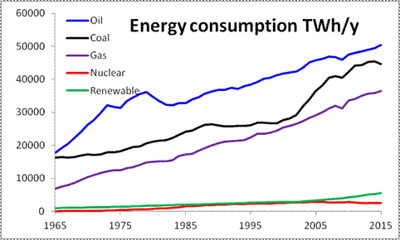

Slide 6
NEED OF SOLAR HYBRID
CONCEPT
Significant number of world’s population lives in remote or rural areas, which are sparsely populated and geographically isolated.
Why SOLAR? –Renewable, inexhaustible, unlimited, noise-free, abundantly available, pollution-free and many.

Slide 7
Common drawback of most of the renewable resources is their dependence on unpredictable factors such as weather and climatic conditions.
This brings to the hybrid power plant concept.

Slide 8
REFERENCE
‘INTERNATIONAL JOURNAL OF ENGINEERING RESEARCH AND APPLICATIONS’ by Shalini S Durgam, Anuradha B Musale, Sneha A Balki, Payal S Gahane, Asst. Prof. L.B. Awale

Slide 9
BASIC PRINCIPLE OF OPERATION
When output from the solar panel is above 12 volts, the battery charges using the solar power. When the output drops below 12 volts, the battery charges through AC mains

Slide 10
In this paper we are proposing a circuit to charge mobiles and laptops using the power generated by the solar panels and AC power.

Slide 11
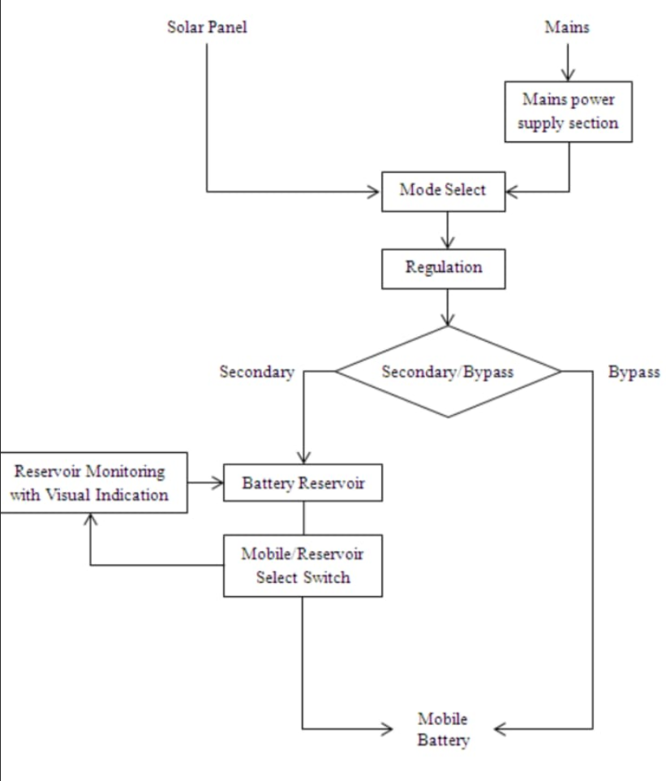
BLOCK DIA

Slide 12
1.In the figure shown the Mode Select is used to decide the way by which the battery is to be charged i.e. from mains or from panel.
2.In Regulation, voltage regulator is used to select the output voltage required to charge the battery.

Slide 13
3.Secondary/Bypass is used to decide whether to charge the battery reservoir or the mobile battery.
4.Bypass mode charges the mobile battery and secondary mode charges the battery reservoir. Both cannot be charged simultaneously.

Slide 14
5.Reservoir Monitoring and Visual Indication helps in monitoring charge of battery reservoir.
6.It will stop stop charging if the battery is fully charged. The LED is used to indicate this.

Slide 15
7.Mode/Reservoir Select Switch decides whether to charge mobile battery using battery reservoir or not.

Slide 16
references
Journal published by Dr.Sudheer kumar Kolkatta University

Slide 17
Real time monitoring and switching
Photovoltaic cell harnesses the basic energy source of the nature The Sun
Although the potential energy depends on the frequency of incident radiation amount of current produced depends on the intensity of the radiation.
Can we totally rely on the sunlight??

Slide 18
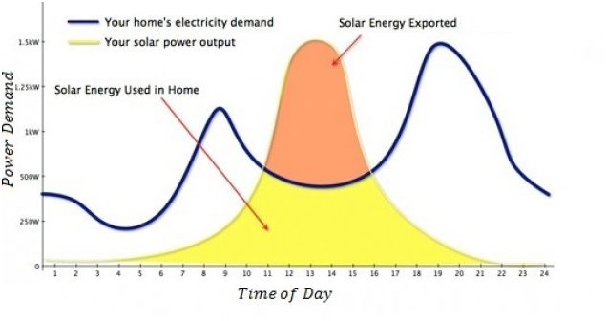

Slide 19
switching
Important part of our project apart from solar charging is ‘SWITCHING’
Technically it is important for us to study how the switching works while we realize our circuit practically.
Switching is between solar and AC source

Slide 20
When solar voltage fluctuates from its specified value
then the Oscilloscope senses its and the fluctuation is seen in
the system. The system checks the condition that we applied
in the program and generates the tripping command from the
program and sends it to the DAQ card.

Slide 21
Then with the help of
DAQ card the designed switching circuitry trips the relay to the
constant D.C. source. At the end of the day the load
successfully shifts from solar panel to constant D.C source.
And the next day when the system monitors that the off-load

Slide 22
reference
‘INTERNATIONAL JOURNAL OF SCIENTIFIC AND TECHNOLOGY RESEARCH VOLUME 4’ by Dr Harshith Agarwal and Vivek Kashyap

Slide 23
UNIT SIZING AND CONTROL OF HYBRID WIND-SOLAR POWER SYSTEMS.

Slide 24
MAINLY FOCUSES ON :
This paper demonstrates the implementation of a prototype of IPS (instant power supply) system to ensure continuous output current to load in residential application utilizing both Photovoltaic (PV) energy and Wind.

Slide 25
In this paper, a hybrid framework that combines the two technologies - equipped with solar panels to scavenge solar energy and the wind turbine .
Solar energy gets priority here to charge storage battery rather than Wind source

Slide 26
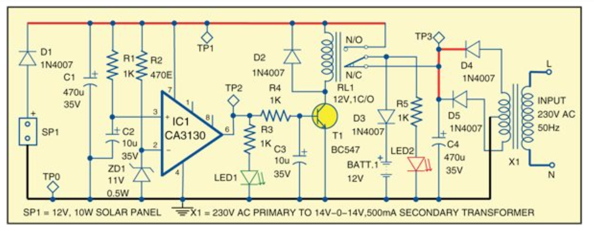

Slide 27
reference
‘INTERNATIONAL JOURNAL OF ENGINEERING RESEARCH’ by Dr Naman Rawat and Monica Verma.
IEEE Journals.

Slide 28
CONCLUSION
Gigantic population and comprehensive electrical energy consumption have made power crisis one of the gravest national problems in the developing countries
HENCE,
It is required to think the methods to generate electricity from other ways to meet the daily needs.

Slide 29

Where the remoteness of the terrain makes power supply unreliable.

Slide 30


ELECTRIFIED INDIA

